Slide 1
2 Overview of the Project
Ferhat Erata
UNIT, ModelWriter Project Leader

Slide 2


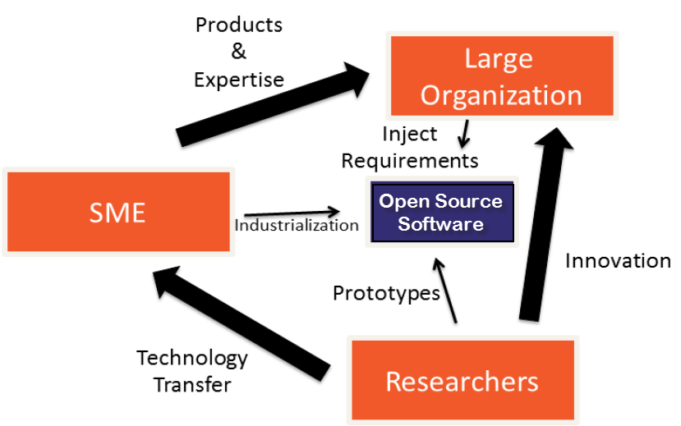







Industrialization Triangle in ModelWriter Open Source Software (year #1)
Industrial Use Cases
Success Stories
Long Term Agreements
ModelWriter
New Product & Services
Commercialization
Open Source Software
Standardization
New Standard or Standard Extension
Publications, Open Source Software
Notes:
Open-Source Software Platform to be submitted to Eclipse Foundation
“MW” Knowledge Dissemination Standard (.mw ModelWriter exchange format)
We transfer the knowledge in university to industry which they develope theory and prototypes.
by means of combining the expertise of SMEs of the consortium (in our case, eclipse)
In this triangle, Large Organizations (most of their dominant core business is not developing software related services) provides the industrial expertise and define requirements
SMEs commercialize the solutions in the market as products.

Slide 3

Industrialization Triangle in ModelWriter Open Source Software (year #2)
Industrial Use Cases
Success Stories
Long Term Agreements
ModelWriter
New Product & Services
Commercialization
Open Source Software
Standardization
New Standard or Standard Extension
Publications, Open Source Software

Slide 4
ModelWriter Project Overview
Resource Allocation: 68,71 person year
Project Duration: 36 months
Planned Budget: 5,543,000 Euro
Start and Finish Date: 01 Oct 2014 – 30 Sep 2017
Open-Source Software Platform to be submitted to Eclipse Foundation

Slide 5
ModelWriter Today’s Knowledge Capture
Knowledge Capture with Word Processors
Document-centric,
Knowledge Capture with Modelling Tools
Model-centric, Structural and formal
Seamless Knowledge Capture with ModelWriter
ModelWriter as integrated product
Technical Documents
Natural Language
Modelling and Model Reasoning tools (= “Model” part),
and keeps both views seamlessly synchronized with each other.
Requirements, Specifications Architectural Design Documents, 3D Design Models …
Very Informal ones (mind maps, text tables, spreadsheets)
Formal ones (UML, SysML, EMF, BPMN …)
Text-based
Semantic Parser & Annotator (= “Writer” part)
Notes:
Let me introduce your three pillar, motivation, three main functionality of the project.
One them is knowledge Capture, The other one is Knowledge Extraction, The third one is Consistency checking.

Slide 6

ModelWriter bi-directional Knowledge Capture tool

Slide 7
ModelWriter Text-Based Knowledge Extraction
Understands the various textual parts of a document expressed in Natural Language
Reveals concepts and relationships between them (“Model”-part)
Semantic Word Processor
(Text-Based Knowledge Extractor)
Consistency & Completeness Checking

Slide 8
ModelWriter Further Knowledge Valorizations
“Everywhere” Document Regeneration: "tell once, show everywhere“: recycling knowledge from (1) the same document, or of (2) another related document
Open Source Software under Eclipse Foundation for Future Dissemination and Exploitation to further extend the Business Value Chain
Consistency Checking: the objective to provide a Consistency Checker that automates Quality Reviews of Requirements Engineering
“MW” Knowledge Dissemination Standard (.mw ModelWriter exchange format)
Notes:
OPEN API: plug-ins (e.g. for a future Natural Language Question Answering System plug-in, domain-specific checkers or generators, etc.)

Slide 9
What is the problem?

Slide 10
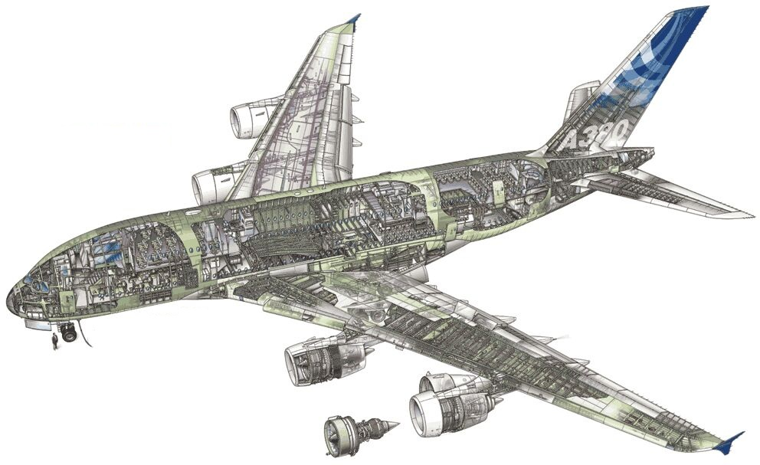
Industrial Use Case in Airbus
Synchronization of regulation documentation with a design rule repository

Slide 11
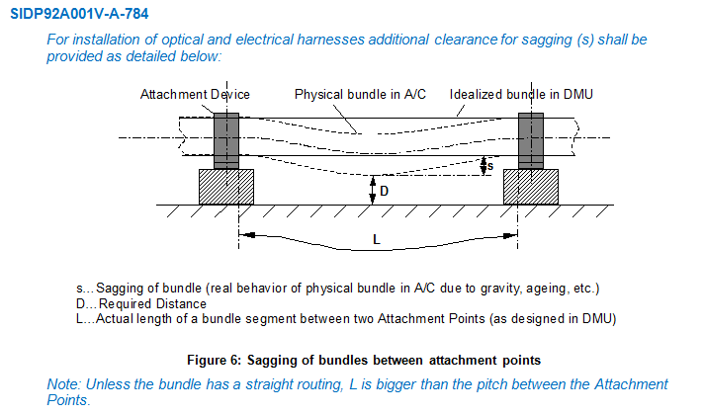
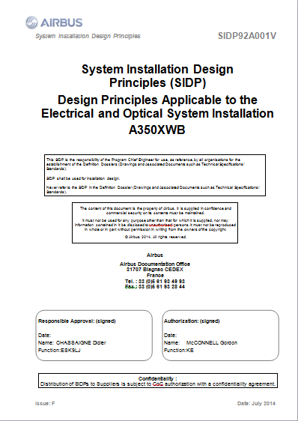
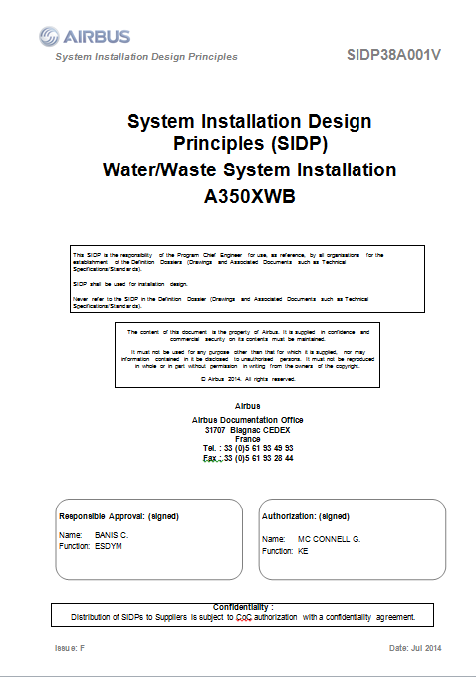
SIDP: System Installation Design Principles
Notes:
SIDP is used (under Non Disclosure agreement) as a use case

Slide 12
Component Ontology and Rules
Objectives:
Manage rules/design principles and improve traceability
Automate identification of design conflicts against rules
ObjectProperties
Component
Assembly
“Structural_Element”
subClassOf
“Bracket”
Physical component
Attachment device
“Fastener”
“Pclamp”
Clamp
AnnotationProperties
Rdfs:label
“Assembly”
Skos:prefLabel
P-Clamp
“P-clamp NSA5516 can be fixed on X with Y”
P-Clamp NSA5516
“Physical component”
“Standard reference”

Slide 13
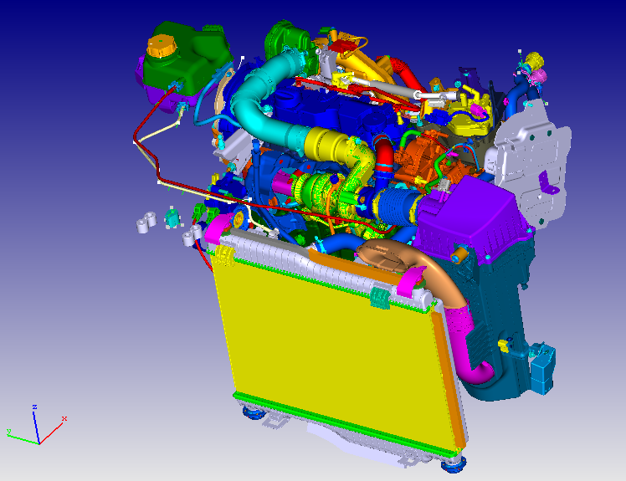
Industrial Use Case in Ford Otosan
Synchronization of Design Specifications with Computer Aided Design Data in Product Lifecycle Management

Slide 14
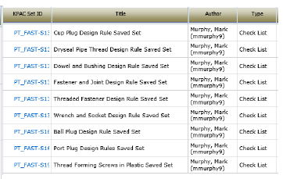
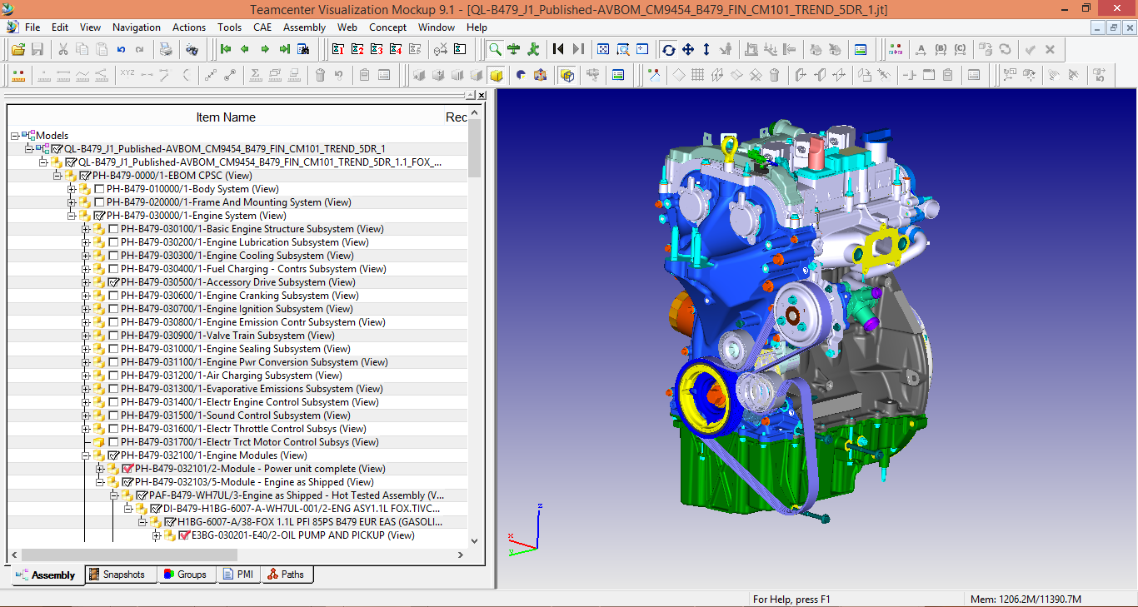
BOM and Design Specifications
“Design Rules”
“Bill of Material Data”
“Computer-aided Design Data”
Notes:
SIDP is used (under Non Disclosure agreement) as a use case

Slide 15
Industrial Use Case in Havelsan
Integration with Application Lifecycle Management to ensure reliability and consistency in the system under development.

Slide 16
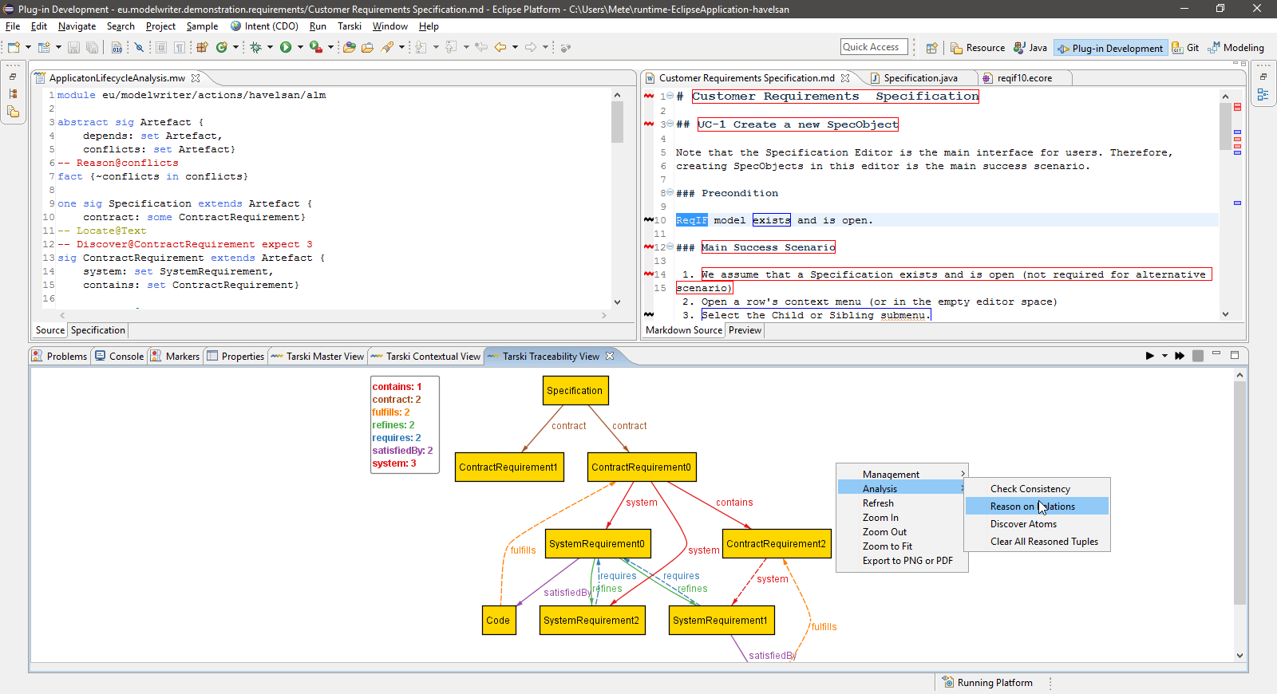
Automated Analysis of Dynamically Configured Traceability Semantics
“Traceability Rules to define traceability semantics”
Artefacts or part of artefacts
“Various Traceability Analysis might be performed”
Notes:
SIDP is used (under Non Disclosure agreement) as a use case

Slide 17
ModelWriter Technological components & interactions
Notes:
ModelWriter teknolojik bileşenleri ve birbiri ile etkileşimleri
Her bir bileşenin gerçekleştirimi teknik bir iş paketi ile yönetiliyor.
Model part, Writer part,
Model Tooling, Writer Tooling,
Knowledge Base,

Slide 18

ModelWriter Conceptual Architecture
Editor
Documents
(doc, docx, odt,textile,etc)
Text
Connectors
Text
Semantic
Module
KB
Model
Models Connectors
Model Integration
Module
Model
Models
Notes:
Simplified version of actual architecture, there is a striking resemblance between planned and actual ones which means logical decomposition of project based on fucntions corresponds the real architecture.

Slide 19
ModelWriter Work Packages & Technical Innovations
WP1 Industrial Use Cases and Requirements (AIRBUS)
WP3 (UNIT)
WP4 (MANTIS)
WP6 (OBEO)
WP2 (LORIA)
Semantic Parser
Bi-directional synchronization mechanism between texts and models
A federated Knowledge Base and its API
A complete “ModelWriter” tool integrating of all these in a consistent way
Synchronization mechanism between texts/models & knowledge base
bi-directional transformation between text and formal knowledge representation
User Interfaces
Consistency checker plug-in for consistency
Configuration & Traceability Components
Document Generation
WP5 Project Management (UNIT)
WP7 Standardization, Dissemination and Exploitation (OBEO)

Slide 20

Level of Collaboration within ModelWriter International Collaboration
Yvan Lussard
Ferhat Erata
Open Source Software (Eclipse Public License)
Eclipse Mylyn Intent Project Lead
ITEA2 ModelWriter Project Lead
AIRBUS SIDP Documentation
Requirement Formalization
Lifecycle Traceability
Dr. Anne Monceaux
ITEA3-ASSUME Project
Oğuzhan Şereflişan
Prof. Geylani Kardaş
Dr. Emrah Kınav
Notes:
New system (Exploitation): Exploitation of ModelWriter in ITEA3-ASSUME

Slide 21


Level of Collaboration within ModelWriter International Collaboration
Prof. Hans Vangheluwe (Chair)
Dr. Anne Monceaux (MC)
MPM4CPS
Ferhat Erata (MC)
University of Antwerp (Grant Holder)
Modeling, Design & Simulation Lab.
Multi-Paradigm Modeling, Formalism Transformation,
Cyber-physical Systems
Software Engineering Research Lab
IC1404 Cost Action for Multi-Paradigm Modeling for Cyber-physical Systems

Slide 22
ModelWriter Activities in the First Year https://github.com/modelwriter/workshops
The 1st International ModelWriter Workshop in Izmir, Turkey (Jan 15-17, 2015) [M4]
The 2nd International ModelWriter Workshop in Brussels, Belgium (Apr 30, 2015) [M7]
The 3rd International ModelWriter Workshop in Toulouse, France (Jun 22-23, 2015) [M10]
The 4th International ModelWriter Workshop in Brussels, Belgium (Sep 23-24, 2015) [M12]
The 1st International Eureka Project Exhibition in Berlin, Germany (Mar 10-11, 2015) [M6]
The 5th International ModelWriter Workshop in Ludwigsburg, Germany (Nov 2-5, 2015) [M16]
Project Kick-off in Istanbul, Turkey (Nov 08, 2014) [M1]
Initial Architectural Design, Indutrial Use Cases, Technical WP discussions
Collaboration Infrastructure
Exploitation: Havelsan’s participation
Consolidated User Requirements & Review
Software Requirements Review & Architecture
Rehearsal & Review
Integration of software components
Notes:
1.
2.
3.
4.
5.

Slide 23
ModelWriter Activities in the Second Year https://github.com/modelwriter/workshops
Product Owner Review Meeting
The 6th International ModelWriter Workshop in Paris, France (Feb 15-16, 2016)
ModelWriter Poster Presentation SAT/SMT/AR Summer School 2016
ICT Cost Action - MPM4CPS WG meeting at Vienna, Austria, on the 15-16 April, 2016
The 7th International ModelWriter Technical Workshop in Toulouse, France (6 June 2016)
The 7th Int’l ModelWriter Brainstorming Session in Toulouse, France at Airbus (9 June 2016)
The 7th Int’l ModelWriter Coordination Meeting in Toulouse, France at Airbus (10 June 2016)
Participation in International Joint Conference on Automated Reasoning (IJCAR) 2016
ModelWriter is positioned on the Working Groups of this Cost Action
Future of ModelWriter is discussed
Poster Presentation
Notes:
1.
2.
3.
4.
5.

Slide 24
ModelWriter Activities in the Second Year https://github.com/modelwriter/workshops
Verification Technology, Systems & Applications (VTSA) Summer School (Aug 29- Sept 02, 2016)
ICT Cost Action - MPM4CPS WG meeting at Gdansk, Poland (Sep 13-16, 2016)
A paper is submitted to ACM Applied Computing Symposium and under review.
The 8th International ModelWriter Technical Workshop in Toulouse, France (13 June 2016)
ICT Cost Action - MPM4CPS WG meeting at Malaga, Spain (Nov 24-25, 2016)
Participation in Workshop on Software Correctness and Reliability (Oct 7-8 2016)
Notes:
1.
2.
3.
4.
5.

Slide 25
What is a text?

Slide 26
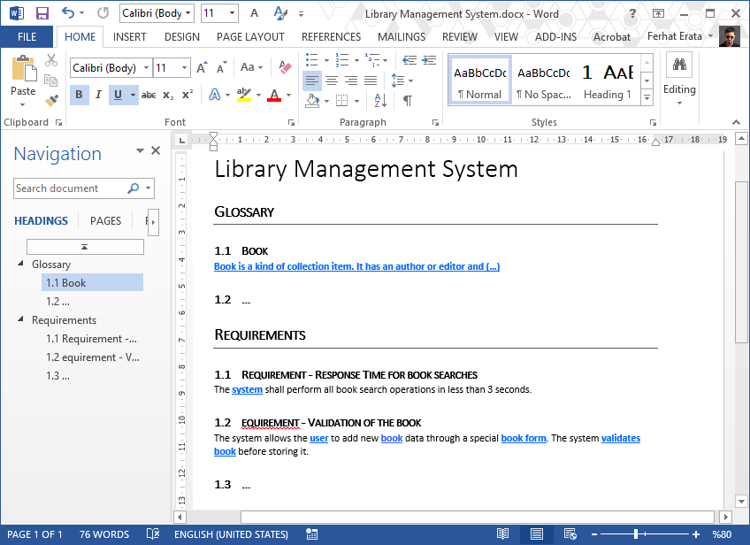
What is a text? (document file formats) Office Open XML (.docx) (ISO/IEC 29500)

Slide 27
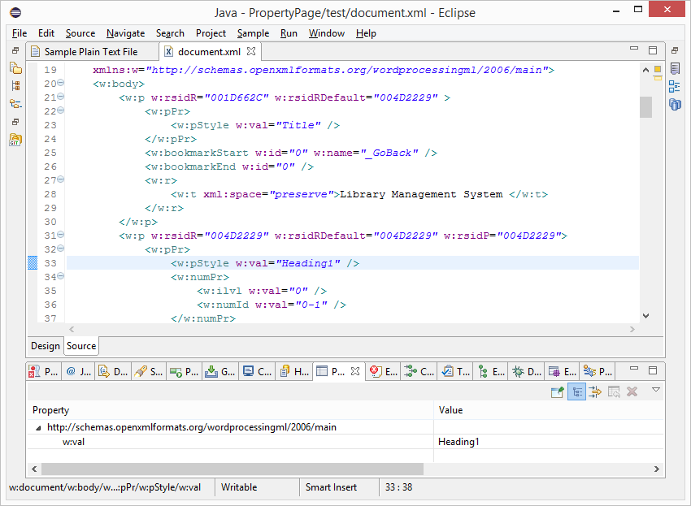
What is a text? (document file formats) Office Open XML (.docx) (ISO/IEC 29500)

Slide 28
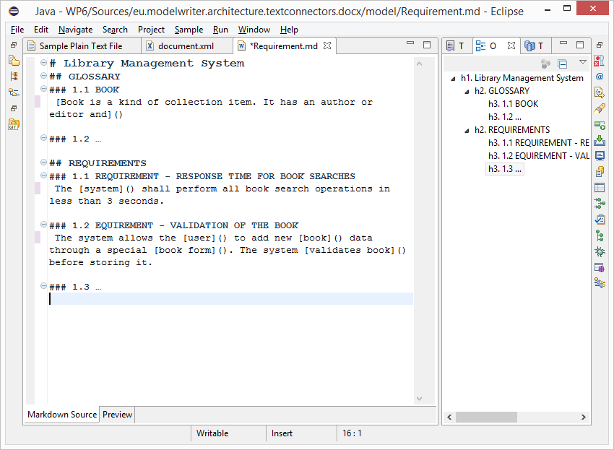
What is a text? (.md source file) text/markdown (ICANN Standard)

Slide 29
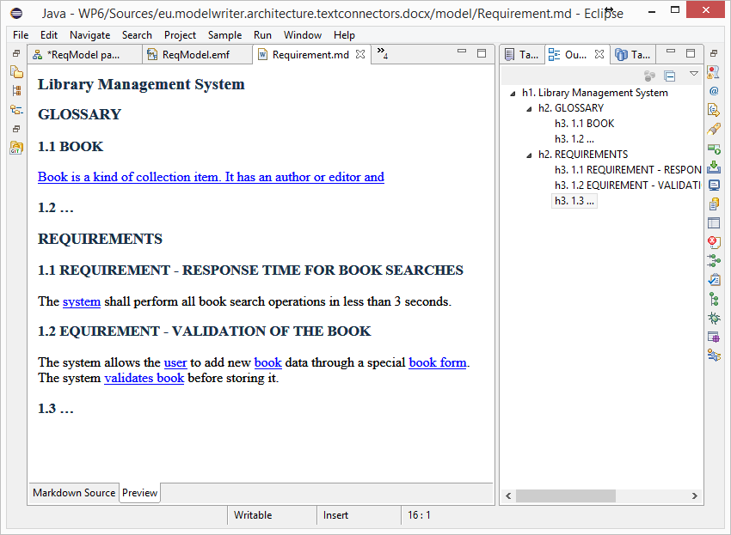
What is a text? (HTML Preview) text/markdown (ICANN Standard)

Slide 30
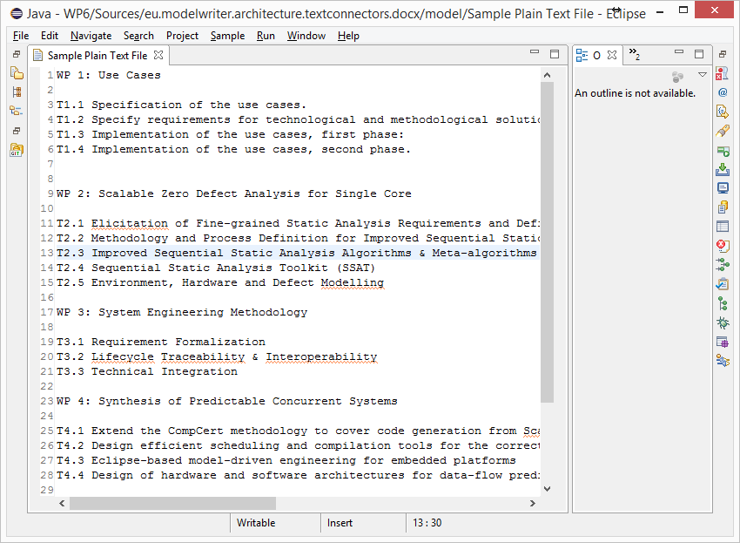
What is a text? (unformatted text) text/plain (ICANN Standard)

Slide 31
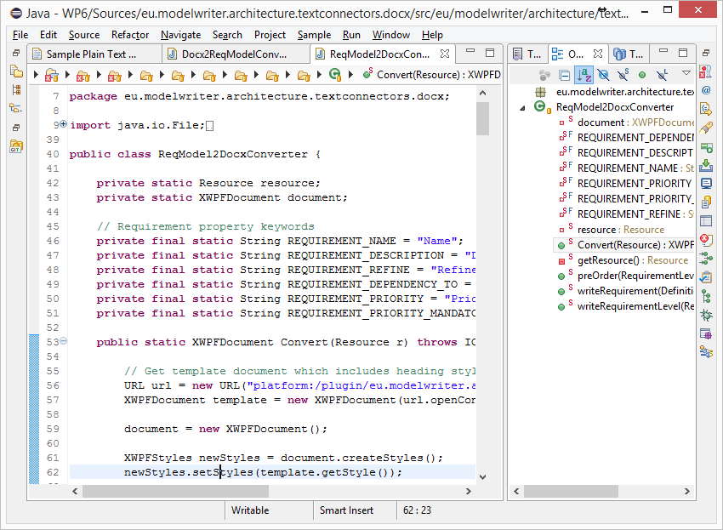
What is a text? (code files) Java, C++ … Programing Languages

Slide 32
What is a model?

Slide 33
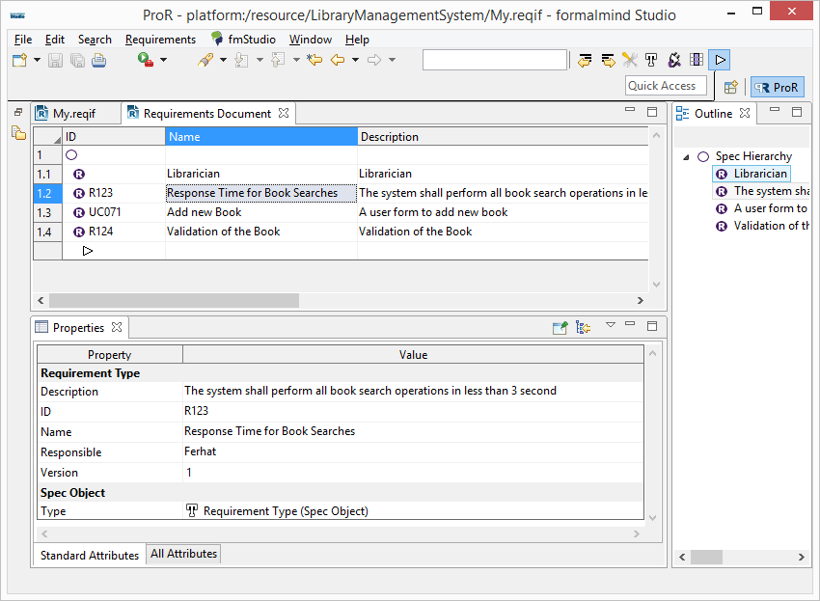
Everything is a model! (ReqIF Standard) Requirements Interchange Format

Slide 34
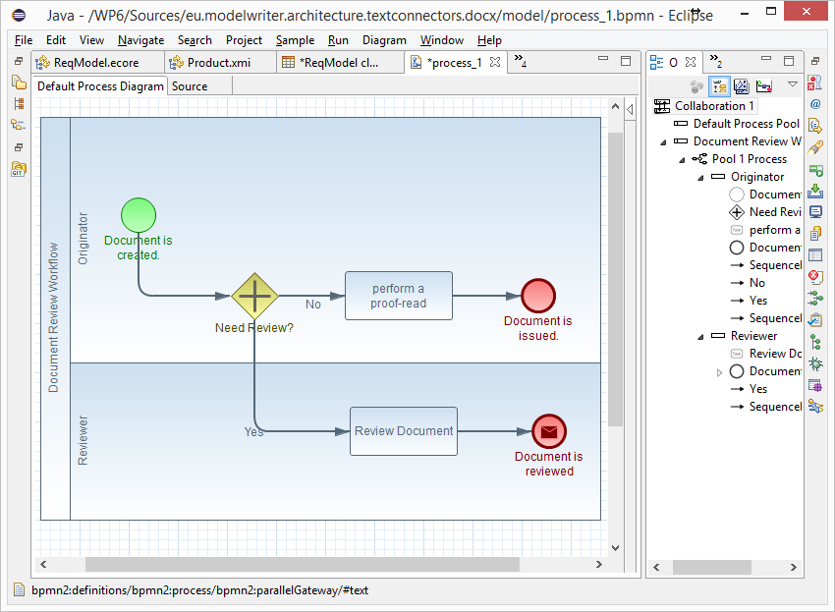
Everything is a model! (BPMN Standard) Business Process Model & Notation

Slide 35
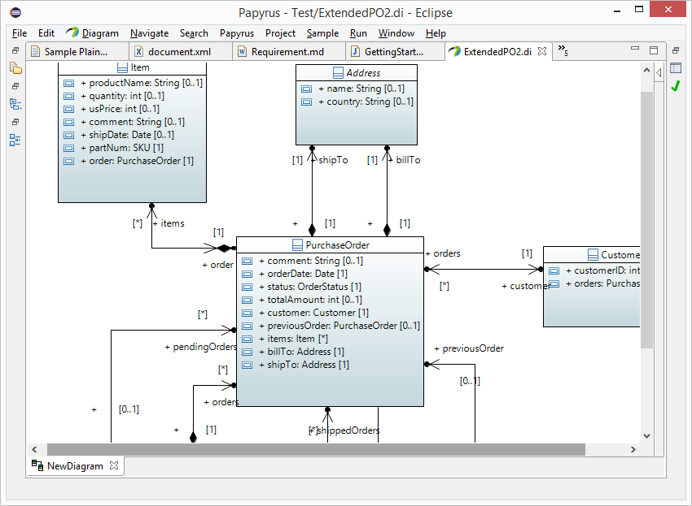
Everything is a model! (UML Standard) UML Modeling Languages

Slide 36
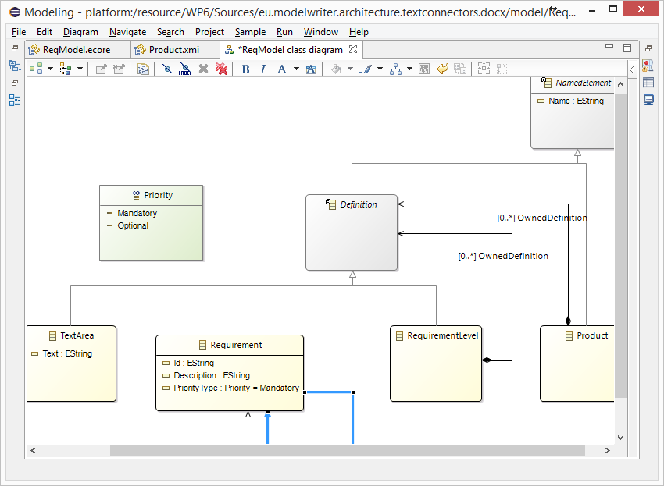
Everything is a model! Eclipse Modeling Framework (EMF)

Slide 37
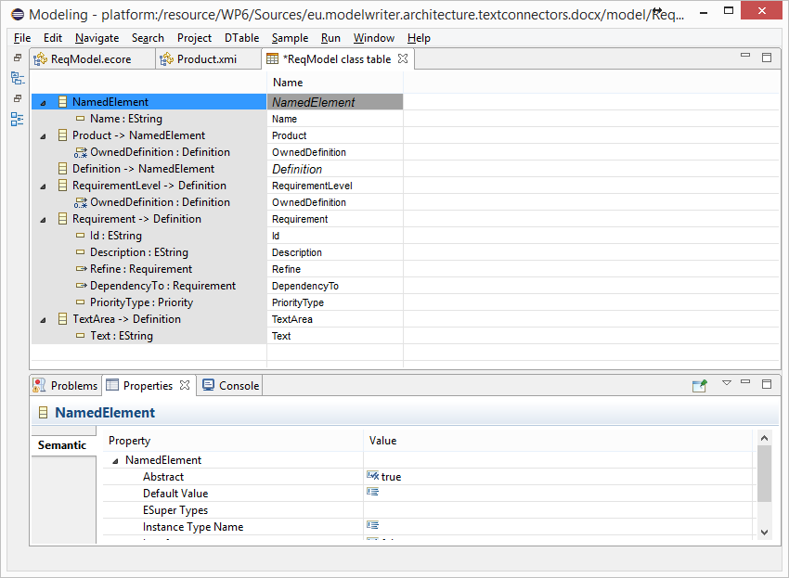
Everything is a model! Tree-based or Tabular Representations

Slide 38
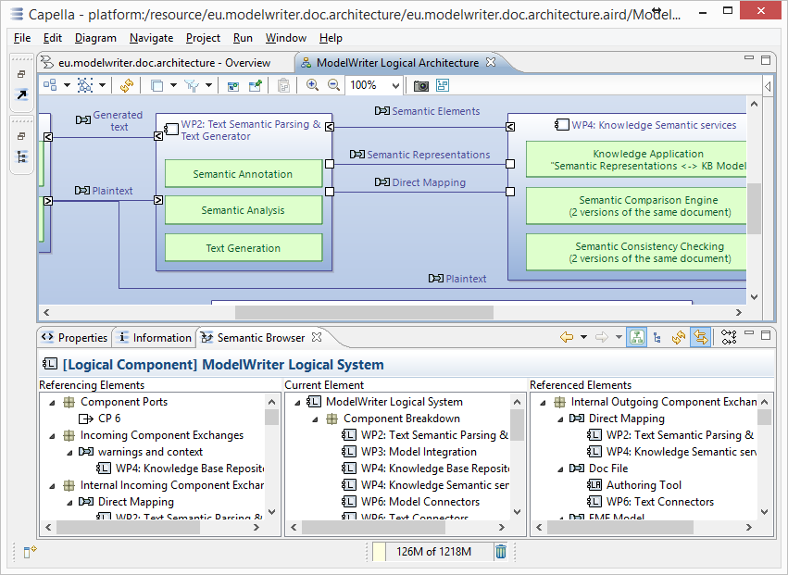
Everything is a model! Software/System Architecture Design

Slide 39
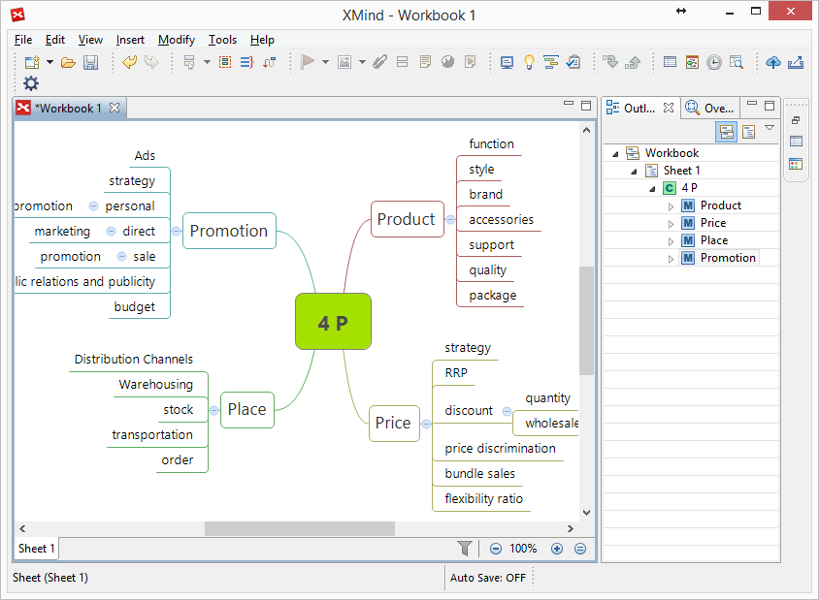
Everything is a model! Topic Maps, Mind Maps, Vocabularies …

Slide 40
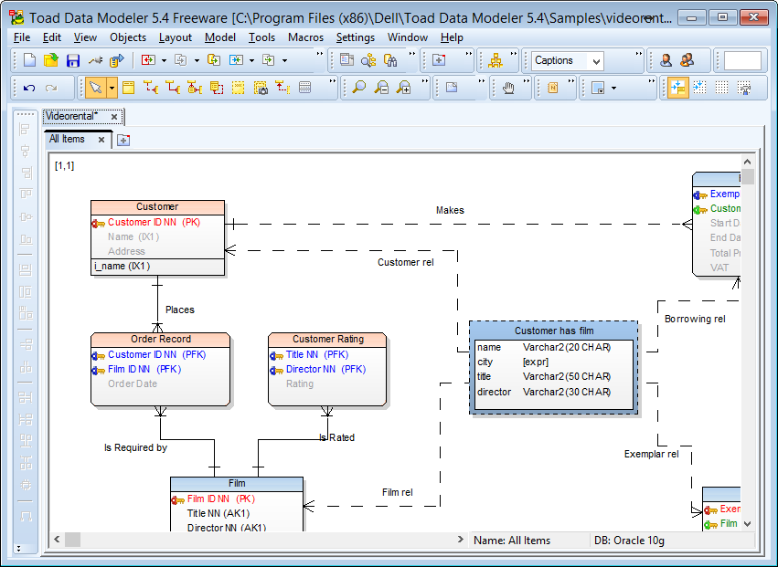
Everything is a model! Databases (ER, IDEF1.x)

Slide 41
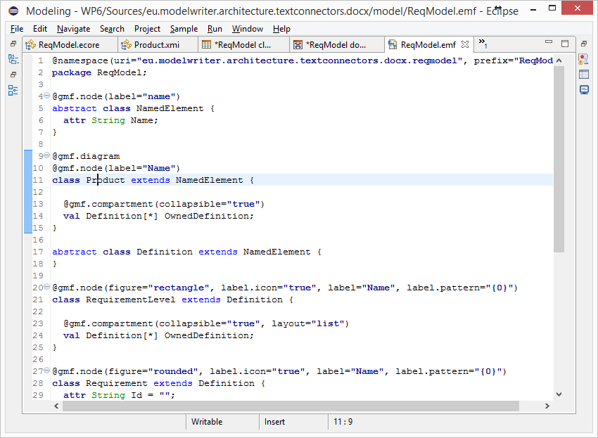
Everything is a model! (Textual Lang.) Domain Specific Languages

Slide 42
Everything is a model! (Java, C++, etc.) Even Programing Languages (ASTs)

Slide 43
Is it possible to connect and keep arbitrary software/system engineering artifacts synchronized ?

Slide 44
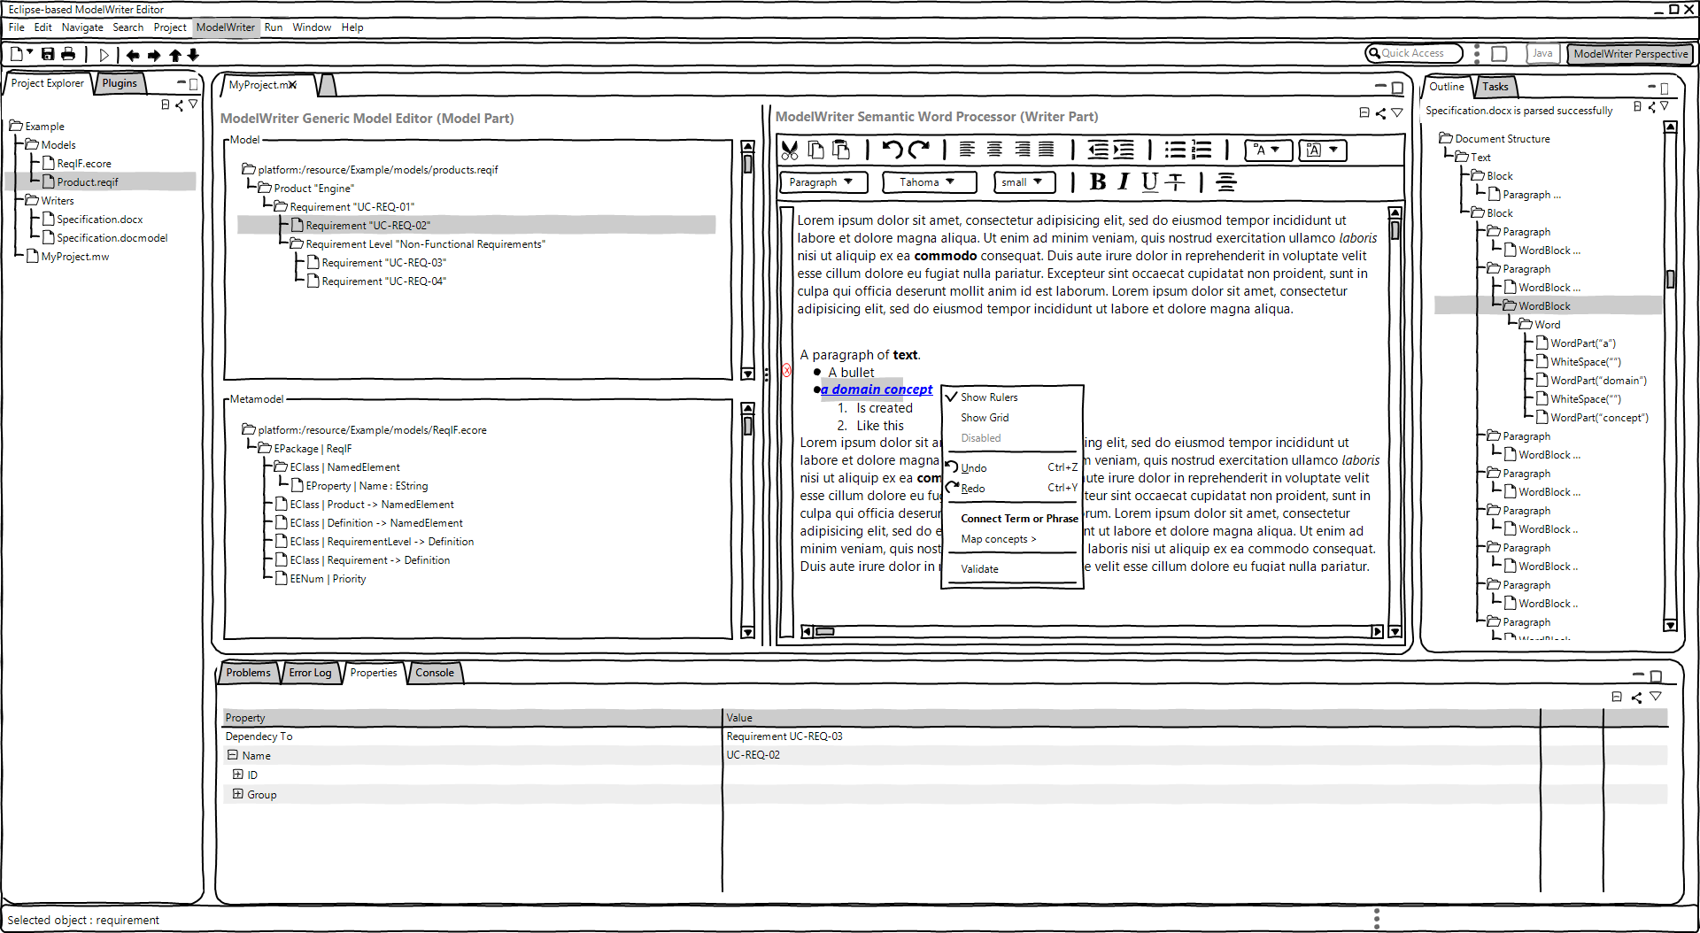
ModelWriter – The Solution
Text & Model-Synchronized Document Engineering Platform

Slide 45
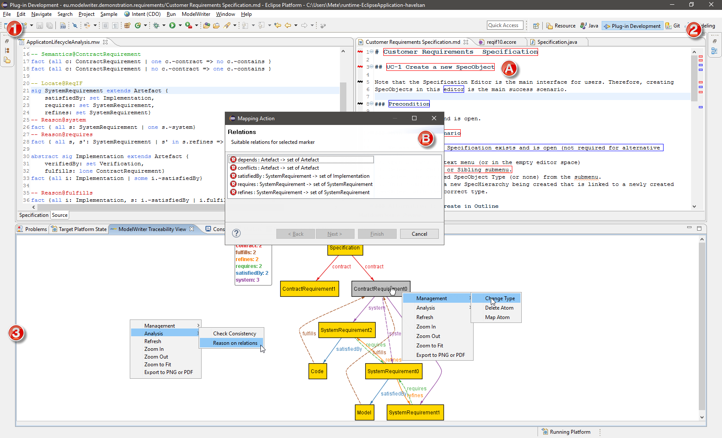
Solution – Knowledge Capture
Text & Model-Synchronized Document Engineering Platform

Slide 46
Is it possible to extract knowledge from texts fragments based on a given ontology (model) ?

Slide 47
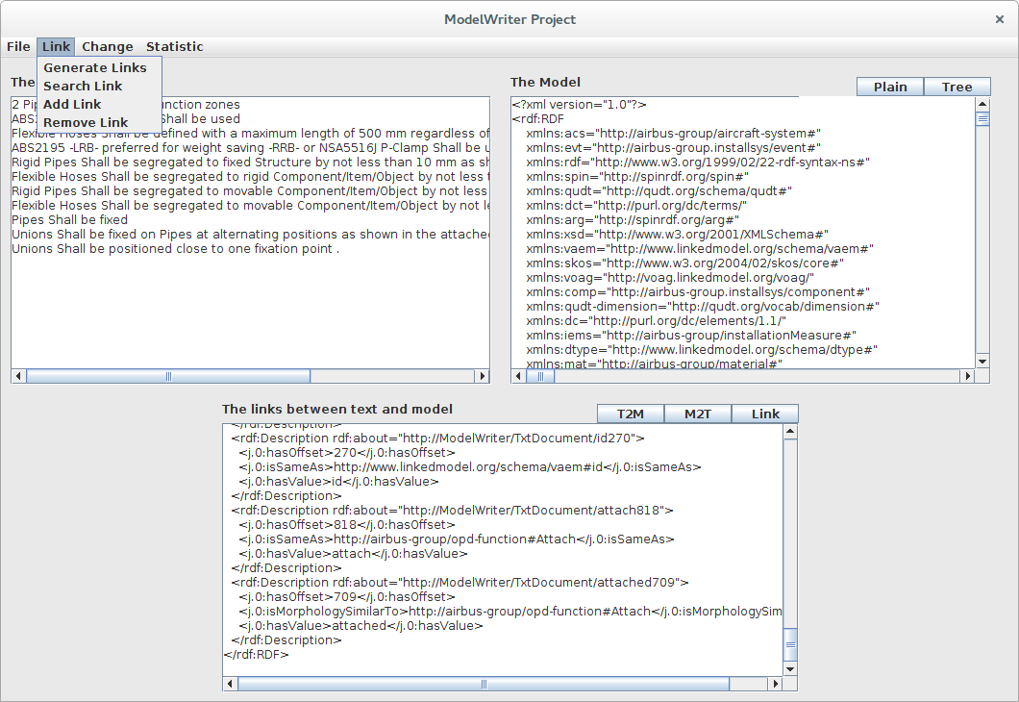
Solution – Knowledge Extraction
Text & Model-Synchronized Document Engineering Platform

Slide 48
Synchronization is maintained!

Slide 49
What about configuration/formalization of the platform?

Slide 50
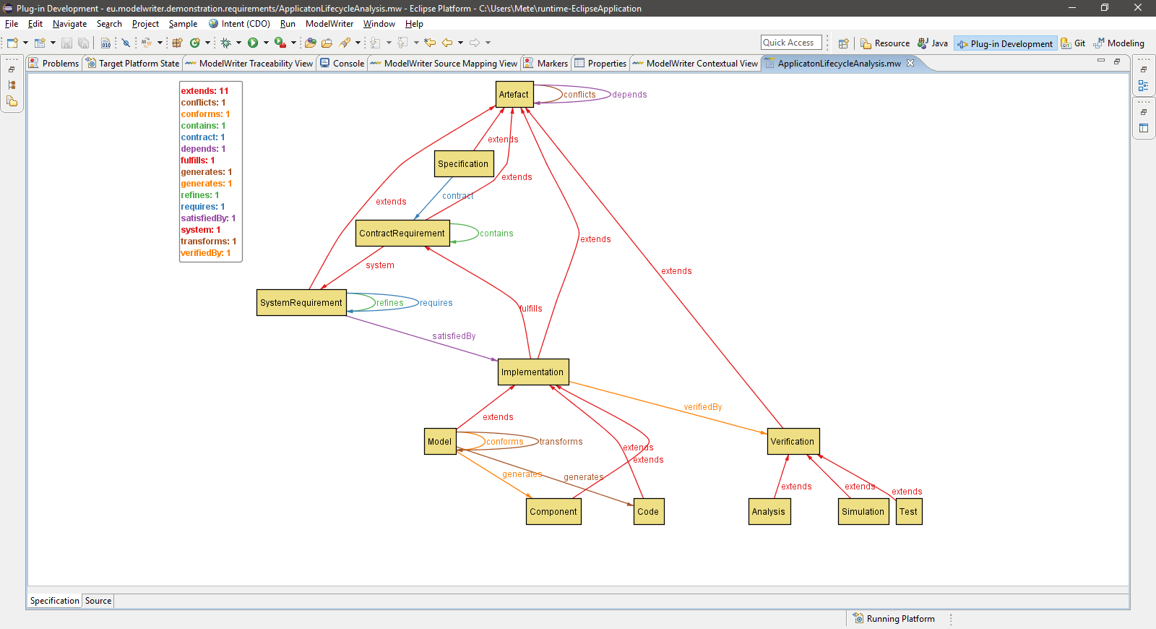
Configuration: Havelsan example
A Formal Specification Model to configure the ModelWriter

Slide 51
Is it possible to vizualize the trace links?

Slide 52
Traceability: Havelsan example
A Formal Specification Model to configure the ModelWriter

Slide 53
Thank you for your attention We value your opinion and questions.

